Slide 1
Easy Street
You are about to see a series of unrelated pictures. For each picture, write a short response. Your response can be anything as long as it is school appropriate and relates to the picture.

Slide 2
Easy Street
In the past, students have
written descriptions of the picture
responded in the style of a Tweet
created a short description of an event leading up to or resulting from the scene captured in the picture
and other imaginative and creative responses
READY? HERE WE GO!

Slide 3
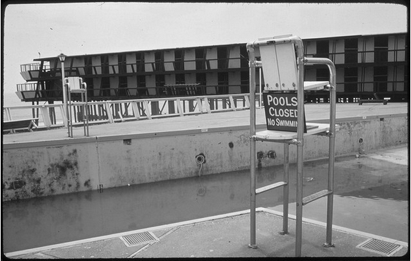

Slide 4
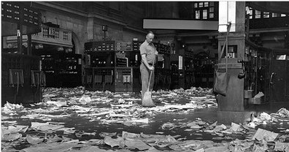

Slide 5
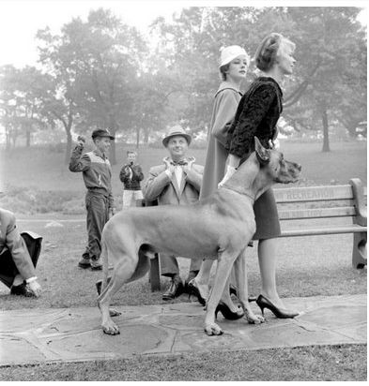

Slide 6
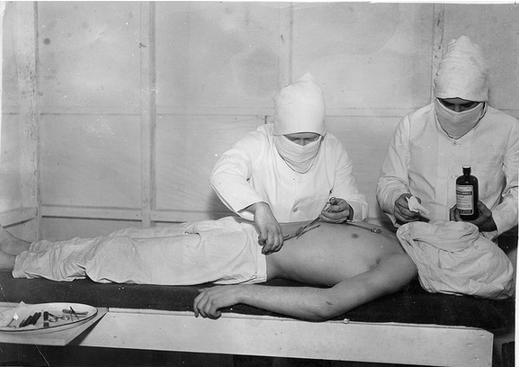

Slide 8
Easy Street
Your task:
Write a 400-600 word story
Your story can be about anything you want (school appropriate of course) but it must include at least two of your responses (word-for-word) and the two (or more) words you chose from the last side.
Start now… this is due at the end of the period

